Slide 1


Student Details-
NAME – RISHABH YADAV
SKILL BUILD EMAIL.ID- RISHABHRAJ7120@GMAIL.COM
Organization - DGT
COLLEGE NAME - NOIDA INSTITUTE OF ENGINEERING AND TECHNOLOGY
COLLEGE STATE - GREATER NOIDA, UTTAR PRADESH
INTERNSHIP DOMAIN- DATA ANALYTICS
INTERNSHIP START-END DATE - 12 JUNE- 24 JULY

Slide 2
Problem Statement
The Superstore database is facing challenges in managing its vast amount of data, leading to inefficiencies in extracting actionable insights, optimizing inventory levels, and improving overall operational efficiency. The current system lacks an effective data management strategy, hindering the organization's growth potential. Therefore, a comprehensive analysis of the Superstore database is necessary to identify areas of improvement and propose effective solutions.

Slide 3

PROJECT TITLE Enhancing Superstore Database Management and Performance

Slide 4
AGENDA
Introduction: Overview of the project and its objectives.
Problem Statement: Analysis of challenges faced by the Superstore database.
Project Overview: High-level description of the project's scope and objectives.
End Users: Identification of stakeholders benefiting from the project.
Solution and Value Proposition: Proposed solution and its benefits.
Customization: Explanation of how the project was tailored to specific needs.
Modelling: Data modelling techniques utilized for database optimization.
Results: Detailed analysis of outcomes, improvements, and future recommendations.
Conclusion: Summary of the project's impact on the Superstore database.

Slide 5
PROJECT OVERVIEW
This project aims to analyse the Superstore database to address challenges in data management and performance. Through a comprehensive examination of the current system, the goal is to propose effective solutions to optimize the database, enhance data accessibility, and improve decision-making processes within the organization.

Slide 6
WHO ARE THE END USERS of this project?
The end users of this project include various stakeholders within the Superstore organization:
Management: Decision-makers relying on data-driven insights for strategic planning and resource allocation.
Operations Team: Staff responsible for inventory management, order processing, and supply chain optimization.
Sales and Marketing Teams: Professionals needing accurate and timely information for driving sales and customer engagement.
Data Analysts: Experts analyzing data to generate reports, identify trends, and provide informed recommendations.

Slide 7
YOUR SOLUTION AND ITS VALUE PROPOSITION
Our proposed solution centres around implementing a robust data management system that incorporates efficient data modelling techniques, streamlines data retrieval processes, and enhances data quality. The key value propositions are as follows:
Improved Data Accessibility: Quick and easy access to relevant data, enabling informed decisions in real-time.
Enhanced Operational Efficiency: Optimized inventory levels, reduced stock outs, and improved supply chain management.
Data-Driven Decision Making: Accurate and reliable insights guiding strategic planning, marketing campaigns, and resource allocation.
Streamlined Reporting: Automated reporting mechanisms to save time and effort, allowing stakeholders to focus on analysis and interpretation.

Slide 8
How did customise the project and Make it your own.
To tailor the project to Superstore's specific needs, we conducted a thorough analysis of the organization's existing data management challenges. We engaged with key stakeholders, held meetings to understand their pain points, and incorporated their feedback throughout the project. This customization ensured that our solution directly addressed the unique requirements of Superstore, making it an effective and impactful solution.

Slide 9
modeling
EXPLORATORY Data Analysis (EDA): EDA techniques were employed to gain initial insights into the data set . This include data visualization through charts , graphs , and plots to understand the distribution of variables , identify outliers , and detect patterns or relationship between different variables.
Statistical Analysis : utilized to uncover correlations trends and patterns within the superstore dataset . These techniques helped in understanding the impact of various factors on sales , customer behavior, and operation efficiency.
Customer segmentations : applied categorize customers based on their attribures and buying behaviour . This allowed for the identification of distinct customer groups with specific needs and prefernces , enabling targeted marketing strategies.

Slide 10
Data visualization: advanced data visualization techniques using tools like python libraries ( matplotlib , seaborn) were used to create visually appealing and information charts , graph and dashboards .
These modelling techniques , methodology and frame work formed the foundation of “ Analysis of superstore dataset “ project for Data analytics , ensuring a systematic and data driven approach to extrct valuable insights from data set.

Slide 11
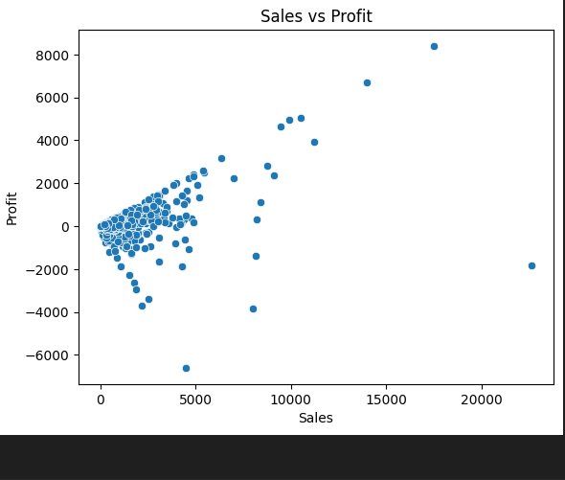
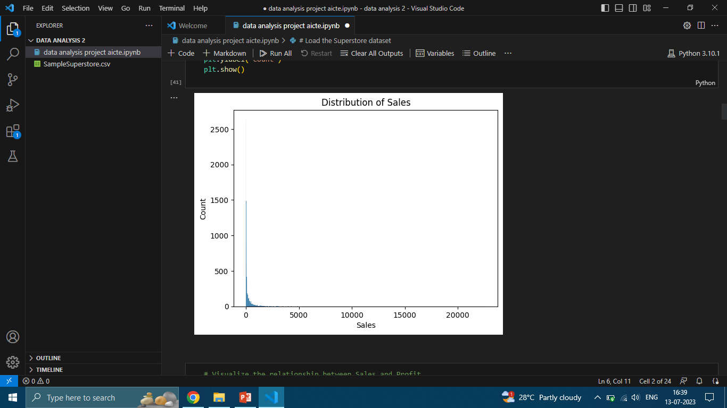
this scatterplot graph shows relationship between Sales and Profit in this graph the profit shows 8000 it in maximum and sales is more than 20000 and right side this visulaize the distribution of sales.

Slide 12
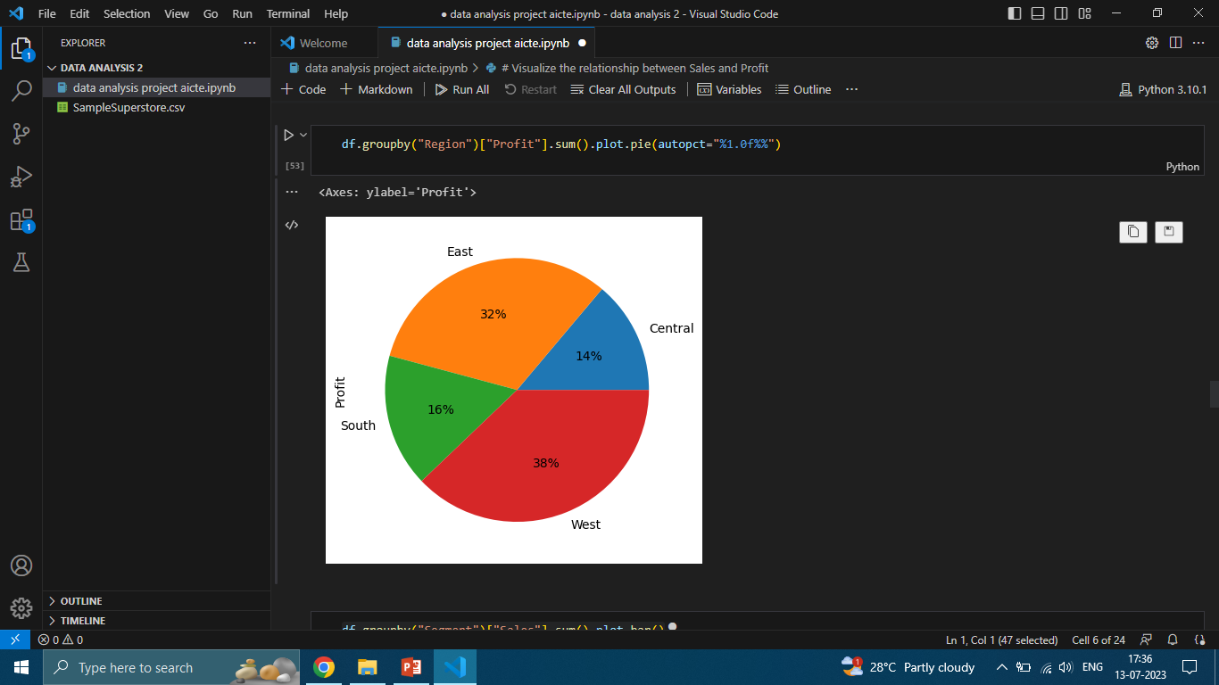
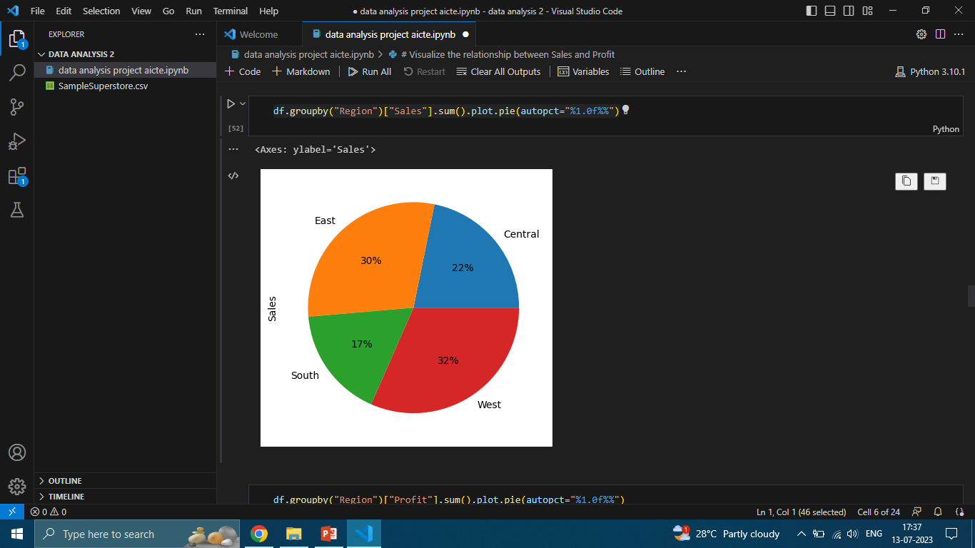
This graph shows the region wise sell and profit in west there profit is 38% and sell is 32% . If any region have more sell then more profit.

Slide 13
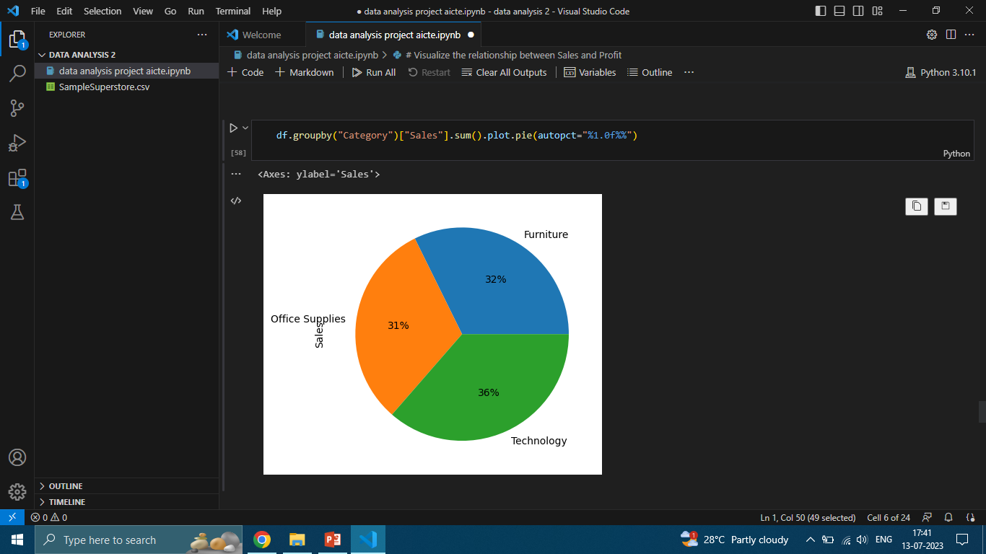
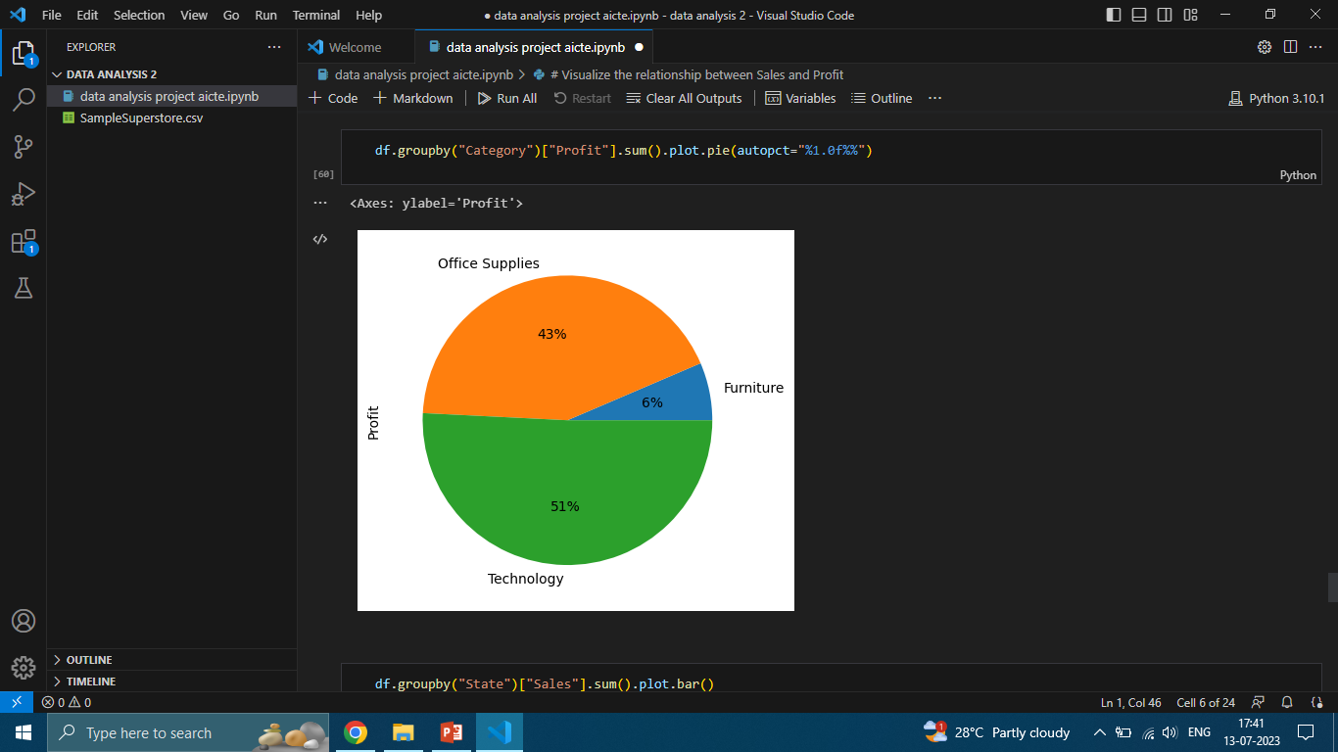
This pie graph show the category wise sales and profit .there is 36% sales in technology and profit is 51% . We conclude that the technology have give the more profit.

Slide 14
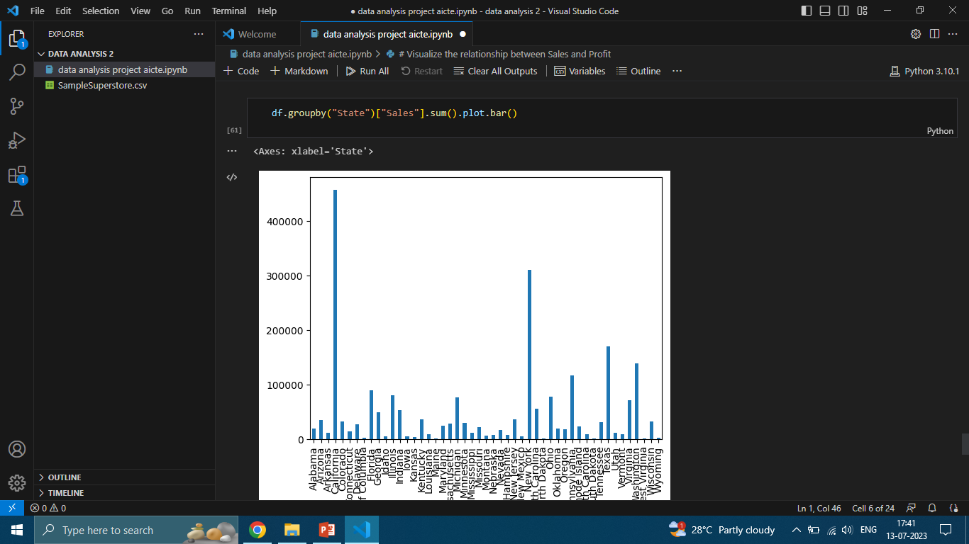

Slide 15
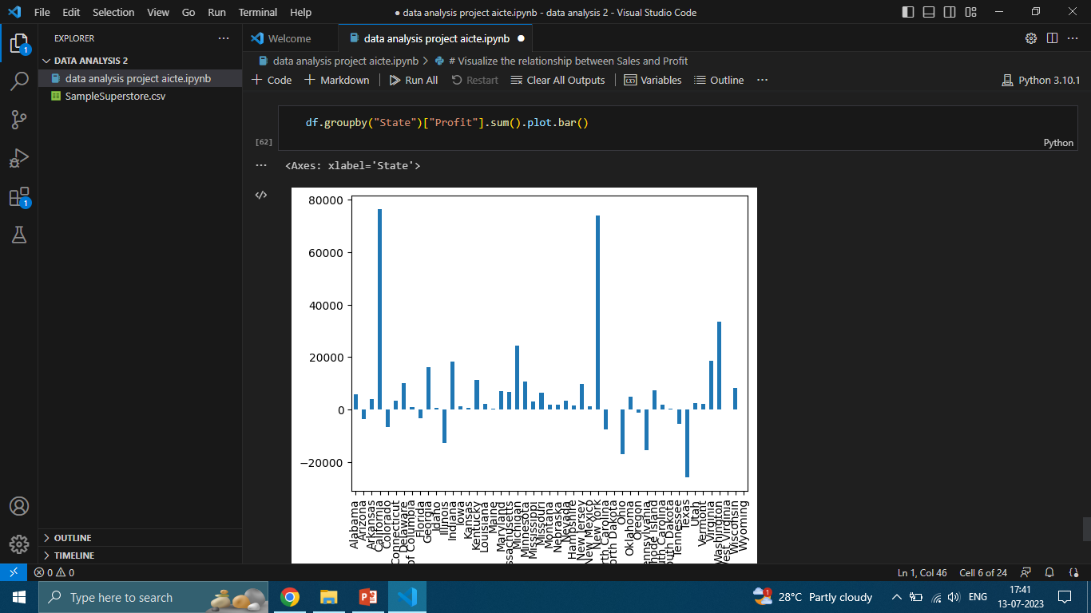
This bar graph show state wise profit so in new York and California show more profit then other state but in many state there loss also.

Slide 16
Results
The analysis and implementation of the proposed solution resulted in the following outcomes:
Improved data accessibility and availability.
Enhanced operational efficiency, leading to reduced stock outs and improved supply chain management.
Informed decision-making processes based on accurate and timely data insights.
Streamlined reporting mechanisms, reducing manual effort and enabling stakeholders to focus on analysis.
In conclusion, the analysis of the Superstore database and the implementation of an optimized data management system have effectively addressed the organization's challenges. The customized solution has led to improved operational efficiency, informed decision-making, and streamlined reporting mechanisms, ultimately contributing to increased profitability and customer satisfaction for Superstore.

Slide 17
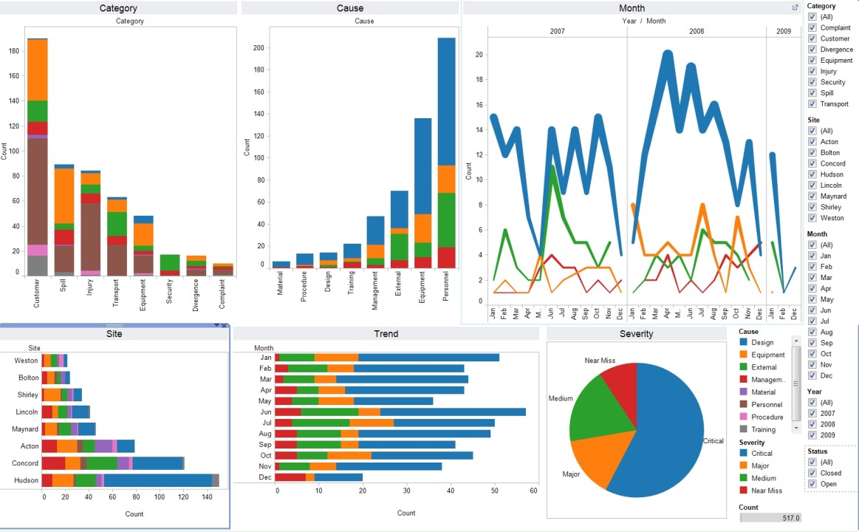

Slide 18
links
https://www.kaggle.com/datasets/bravehart101/sample-supermarket-dataset
Git hub link :
https://github.com/Rishabh033/data-analysis-2.git

